Slide 1


Grounded CAD: Geometry Whispers For CAD Edit
Team: Night Owls
Reiki Tanaya Karuka
Department of Mechanical engineering
rkaruka@mtu.edu
Lenin Goud Athikam
Department of Computer Science
lathikam@mtu.edu
Problem Statement 3

Slide 2

Motivation:
Engineering changes and rework consume 30–50% of engineering capacity. (de Melo, Vieira & Bredillet, 2022)
90% of engineering teams receive supplier feedback too late, often causing redesign and production delays. (CoLab, State of Supplier Collaboration, 2025)
Traditional CAD workflows rely heavily on time-intensive manual iterations and specialized expertise. Our approach uses gen AI to edit and refine existing models, reducing the time required to achieve the designer’s intended outcome.

Slide 3
Grounded CAD: Model
Inputs: Instruction + STEP model
Grounder: Builds a B-Rep geometry census: solids, faces, holes, edges, dimensions, and candidate locations.
Classifier: Parses operation, dimensions, direction, and target type.
Planner: Selects deterministic local CAD operations or a constrained CadQuery fallback.
Executor: Runs edits in an isolated CadQuery/OpenCascade sandbox.
Verifier: Checks STEP validity, geometric change, locality, and requested edit evidence.
Critic/Retry: Uses failure signals to revise a failed attempt.
Parquet File
.Step
Grounder
Classifier
Planner
Executor
Verifier
No
Critic
Yes
Output

Slide 4
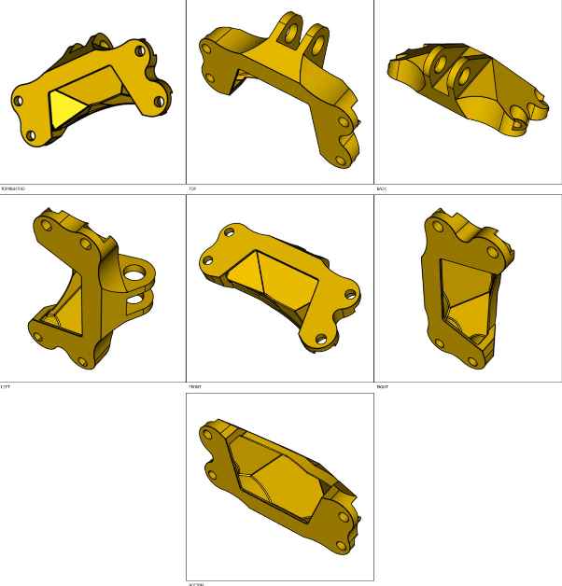
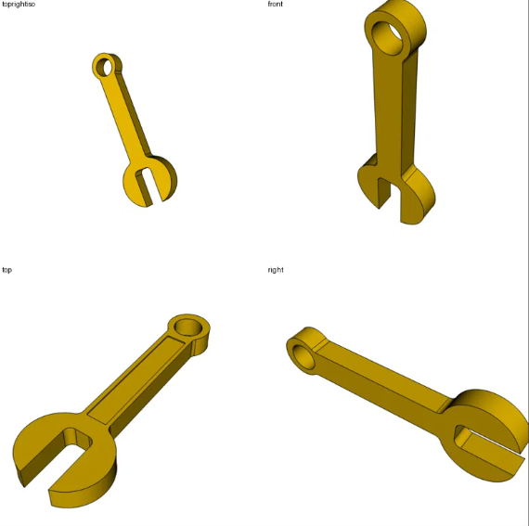
Grounded CAD:
Geometry census narrows the target to concrete B-Rep entities.
Local candidate edits are tried before unconstrained code generation.
Verification rejects unchanged, invalid, oversized, and wrong-scope outputs.

Slide 5
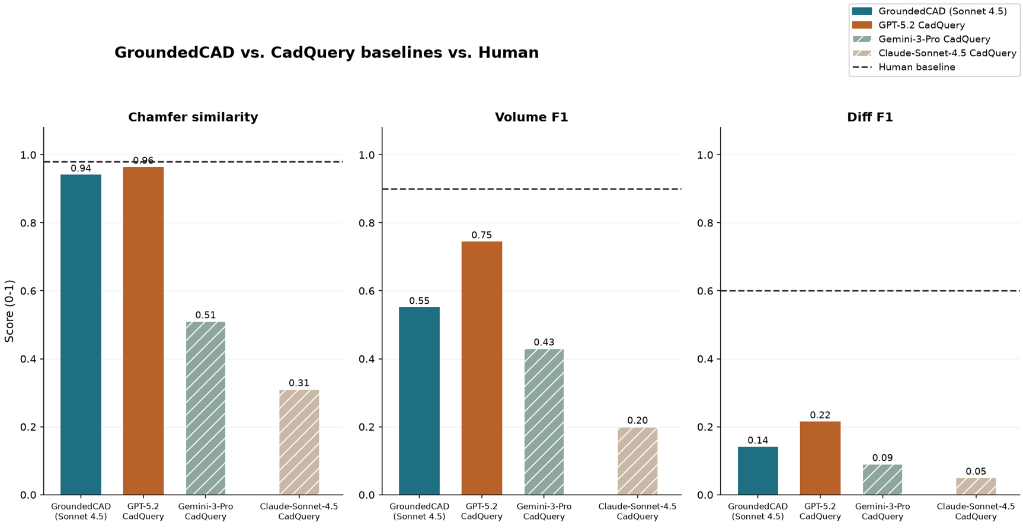
Grounded CAD: Results

Slide 6
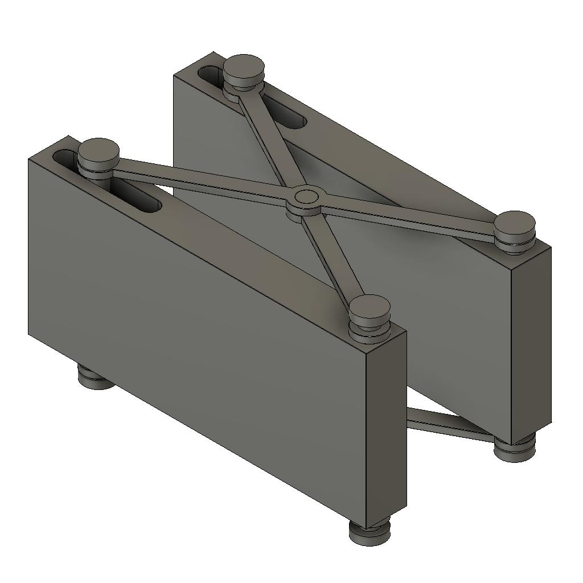
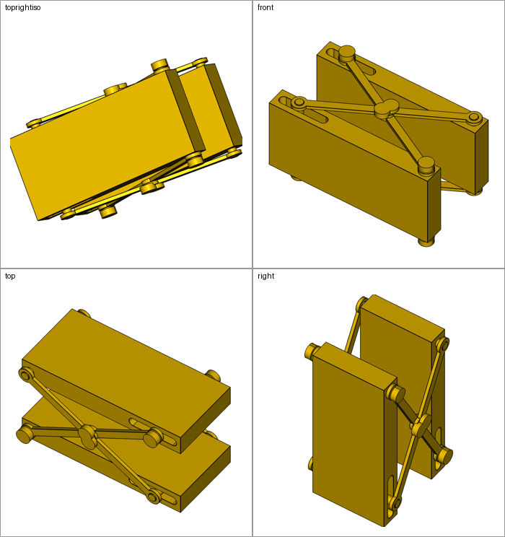
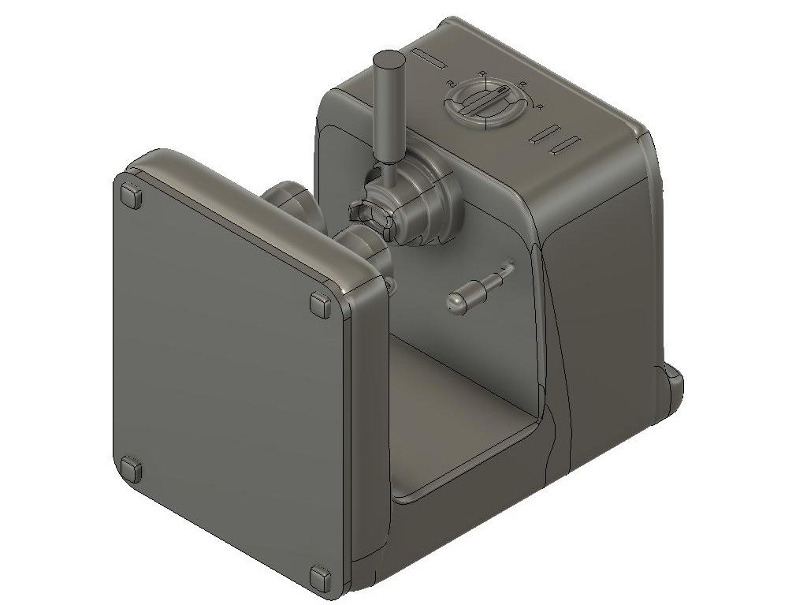
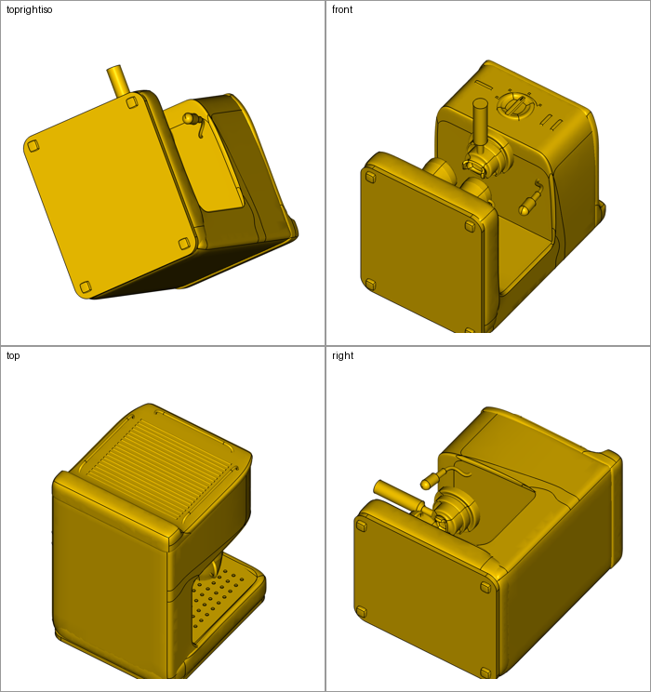
Grounded CAD: Results
Initial Model | Grounded CAD | Scores
 |  | Diff F1 0.2338 Vol F1 0.9350 Chamfer 0.9865
 |  | Diff F1 0.1186 Vol F1 0.3877 Chamfer 0.9759

Slide 7
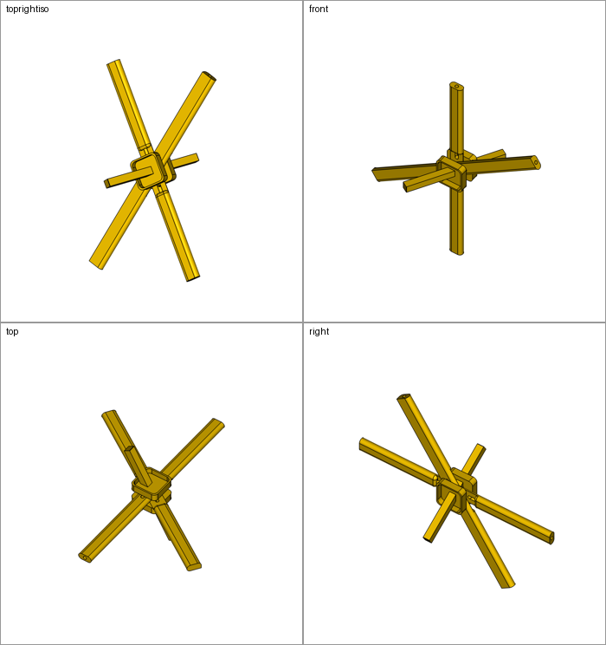
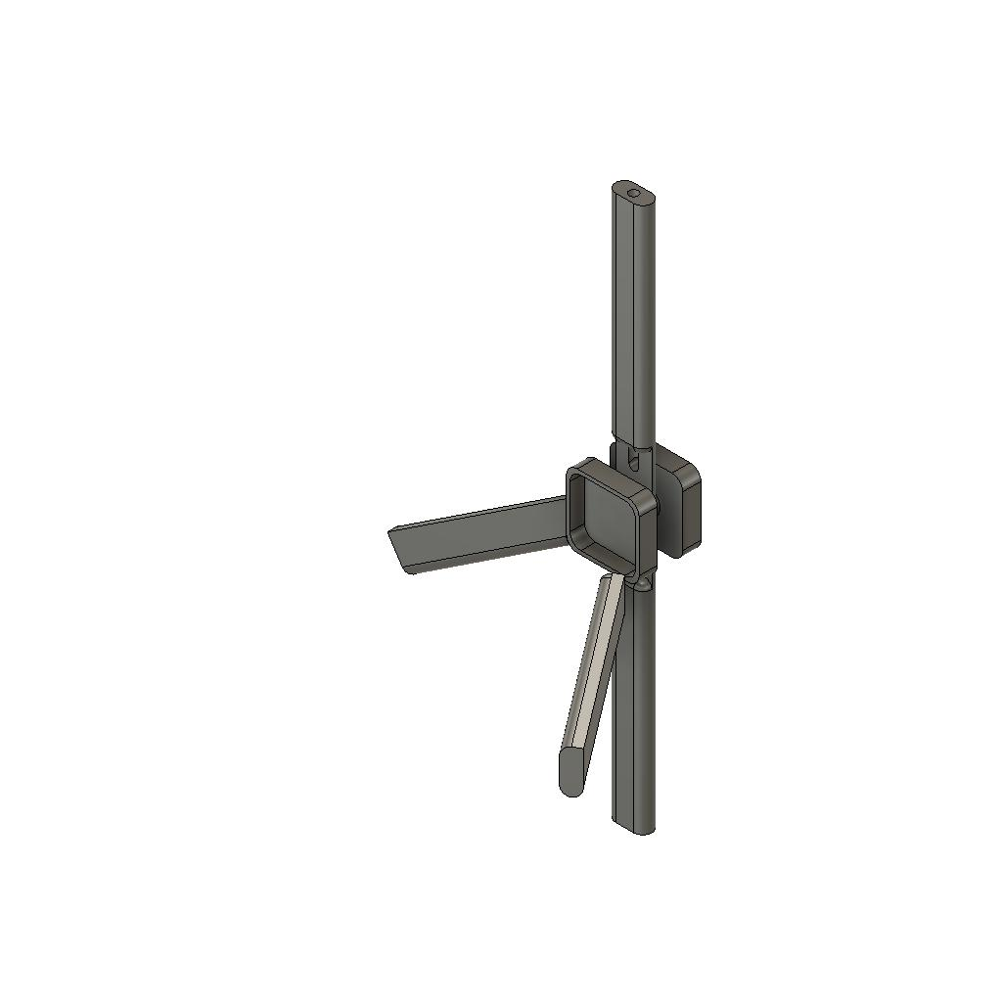
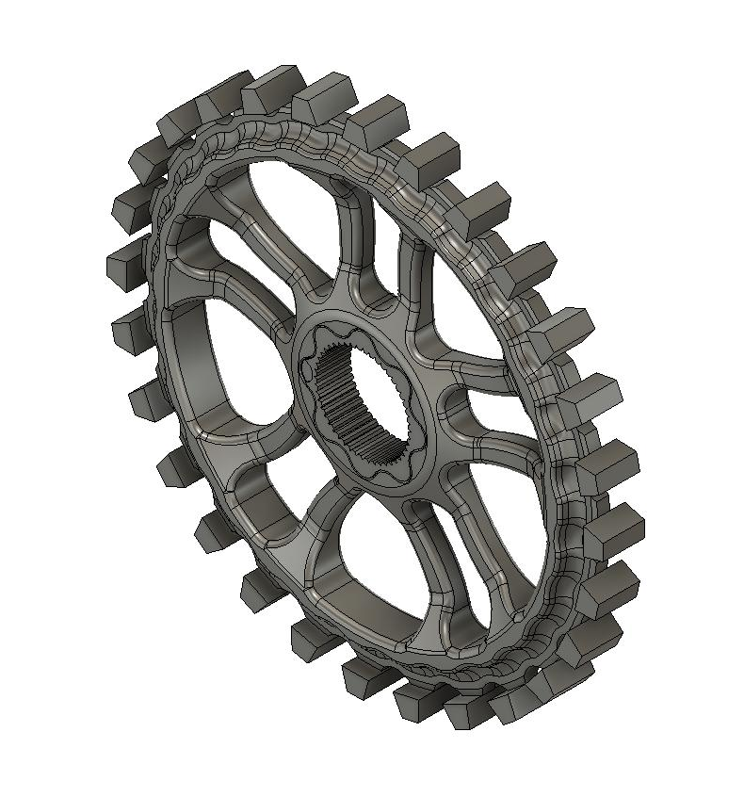
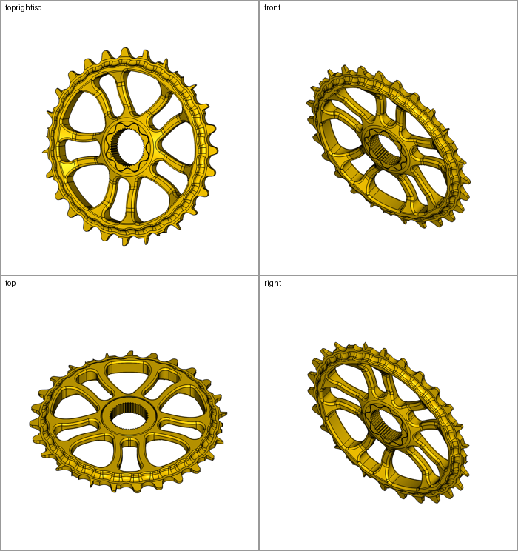
Grounded CAD: Results
Initial Model | Grounded CAD | Scores
Add third rotor blade to assembly |  | Diff F1 0.2453 Vol F1 0.6384 Chamfer 0.9776
 |  | Diff F1 0.286 Vol F1 0.4688 Chamfer 0.9490

Slide 8
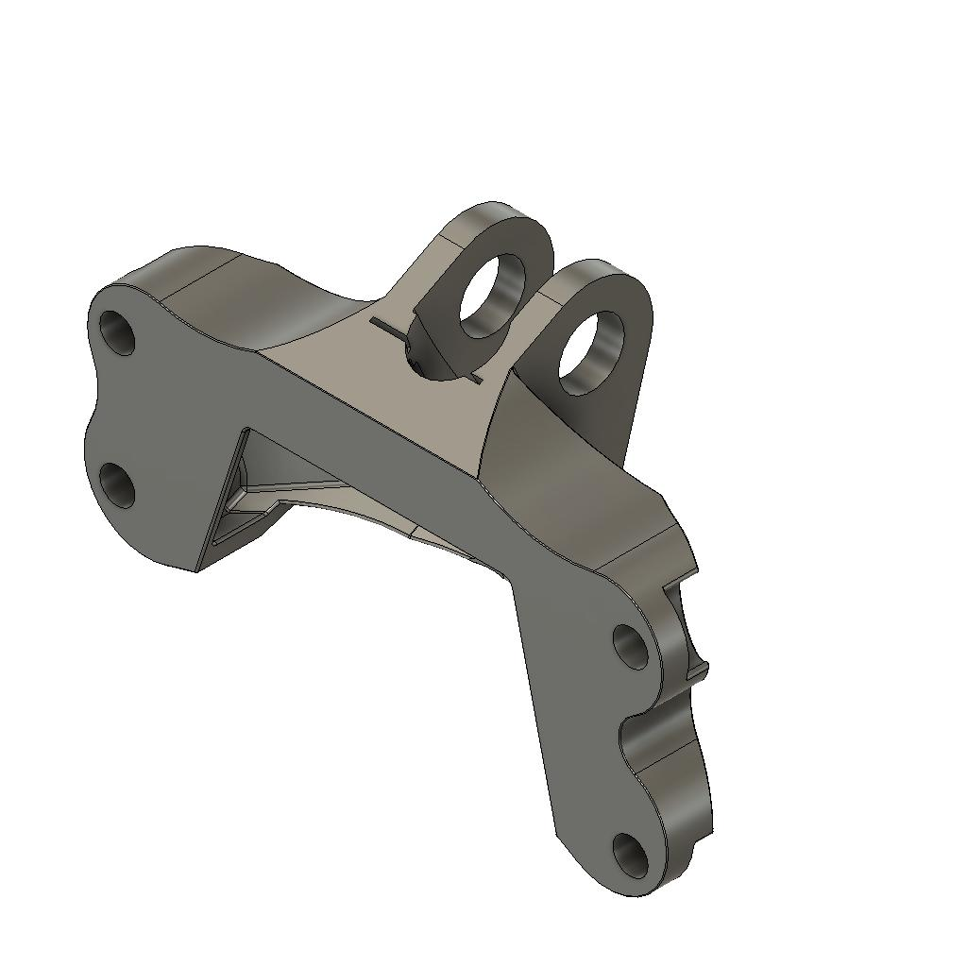
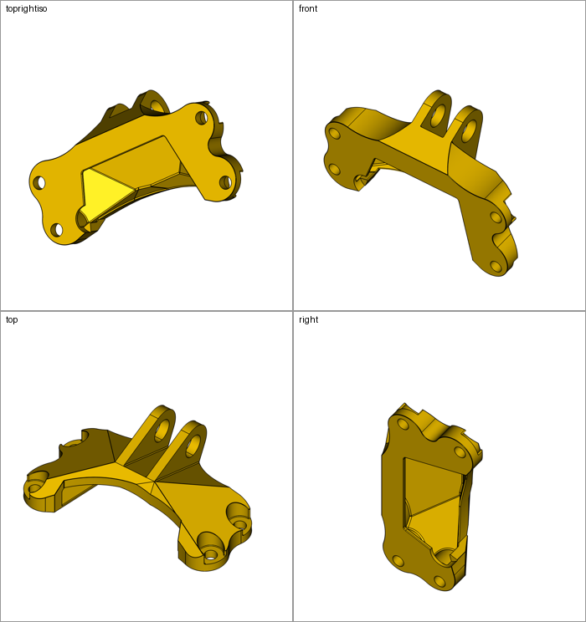
Grounded CAD: Results
Initial Model | Grounded CAD
 |  | Diff F1 0.0795 Vol F1 0.7885 Chamfer 0.9817

Slide 9

Grounded CAD: Cost Efficiency & Scalability
Token efficiency
Scalability efficiency
The harness avoids sending full STEP text to the model.
Instead, it sends compact geometry summaries, orthographic view sheets, parsed dimensions, and targeted retry feedback.
Deterministic candidates handle cheap local edits before spending GPT calls.
Each row runs in a child process with a watchdog.
Large assemblies skip expensive source rendering when it risks freezing the benchmark.
Timeouts are no longer scored as ordinary valid predictions.

Slide 10
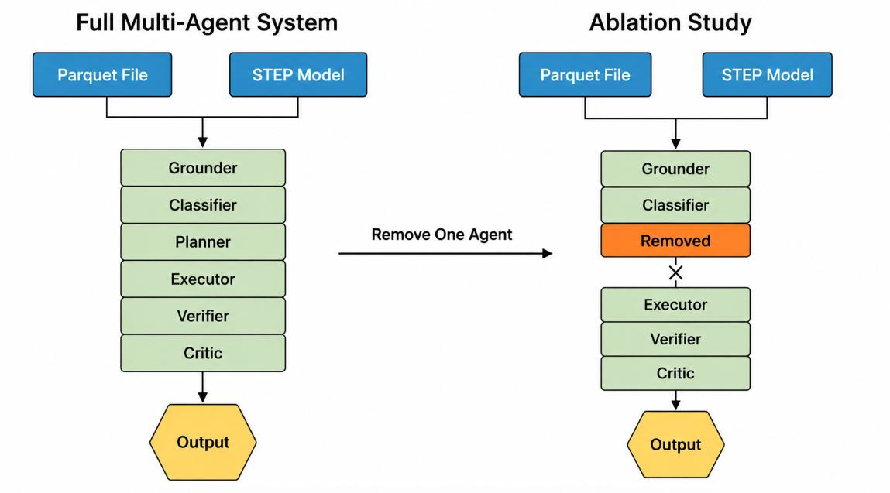
Ablation Study Observation:
Ablation - To see which agent contributes more to the model overall success.
Tested a mixture of 15 different level rows to see the agent effect on the overall workflow.
Component Tested | Success Rate | Diff_F1
Grounder | 60% (9/15) | 0.1007
Classifier | 60% (9/15) | 0.1112
Planner | 60% (9/15) | 0.0897
Executor | 60% (9/15) | 0.0809
Verifier | 66.7% (10/15) | 0.0829
Critic | 60% (9/15) | 0.0921
Groundcad (with all agents) | 60% (9/15) | 0.1151

Slide 11
Ablation Study Observation:
Component Tested | Observed Effect
Orthographic sheet | Helped visual grounding after true axis-aligned views were fixed
Generic image highlighting | Reduced score because highlights confused target selection
STEP / ISO RAG | Added tokens and latency with limited benefit over compact geometry census
Candidate enumeration | Avoided identity outputs, but sometimes selected the wrong edge or scope
Failure buckets | Gave useful retry signals: identity, wrong_edge_or_scope, over_edit, OCC failure
Watchdog isolation | Prevented frozen or partial rows from being scored as valid predictions

Slide 12
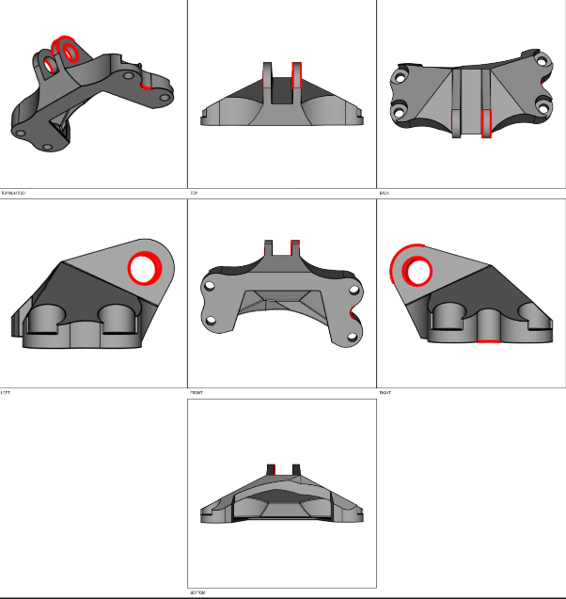
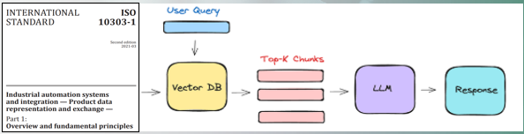
Limitations, Observations & Future scope:
Wrong feature/edge selection remains the dominant cause of low D.
Complex multi-solid assemblies can cause OpenCascade boolean or rendering timeouts.
Image highlighting was not reliable enough for generic CAD features.
STEP-derived B-Rep facts were more useful than broad RAG retrieval.
Next: Confidence-gated deterministic operations and stronger local feature matching.

